Slide 1

Edison Development using C/C++
hello@hybus.net

Slide 2
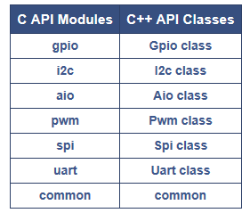
GNU/Linux Platform
Libmraa is a C/C++ library with bindings to javascript & python to interface with the IO on Galileo, Edison & other platforms, with a structured and sane API where port names/numbering matches the board that you are on.
Use of libmraa does not tie you to specific hardware with board detection done at runtime you can create portable code that will work across the supported platforms.
The intent is to make it easier for developers and sensor manufacturers to map their sensors & actuators on top of supported hardware and to allow control of low level communication protocol by high level languages & constructs.
API
These interfaces allow you to interact with all libmraa functionality. The C++ classes directly wrap the C API and provide a near 1:1 mapping of functionality
source : http://iotdk.intel.com/docs/master/mraa/index.html

Slide 3
mraa library
Let's start working with mraa library. We will check mraa library version using mraa_get_version() .
root@Hello:~# vi mraaversion.c
terminal
Example code
#include <stdio.h>
#include <syslog.h>
#include <mraa.h>
int main ( int argc, char ** argv) {
mraa_result_t ret;
ret = mraa_set_log_level(LOG_DEBUG);
fprintf(stdout, "Mraa version: %s \n " ,mraa_get_version());
mraa_deinit();
return ret;
}

Slide 4
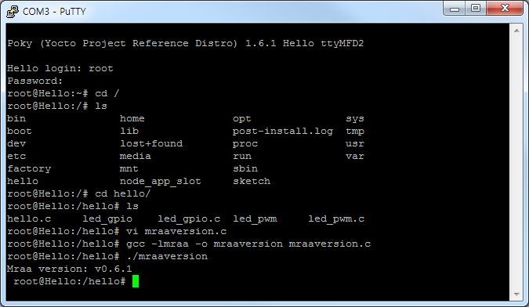
mraa library
root@Hello:~# gcc –lmraa –o mraaversion mraaversion.c
root@Hello:~# ./mraaversion
terminal

Slide 5
PWM LED Control
root@Hello:~# vi led_pwm.c
terminal
#include <stdio.h>
#include <mraa/pwm.h>
int main(){
int i = 0;
mraa_pwm_context led;
led = mraa_pwm_init(9); //pwm context init
mraa_pwm_period_us(led,200); //pulse폭
mraa_pwm_enable(led,1); //pwm pin을 enable상태로 설정
float brightness = 0.0f;
float increment = 0.0f;
while(1){
if(brightness >=1){
increment = -0.001f;
}else if(brightness <= 0){
increment = 0.001f;
}
brightness = brightness + increment;
fprintf(stdout, "LED Brightness : %f \n", brightness);
mraa_pwm_write(led, brightness);
}
mraa_pwm_close(led);
return MRAA_SUCCESS;
}
Example code
source : http://cafe.naver.com/thingdue

Slide 6
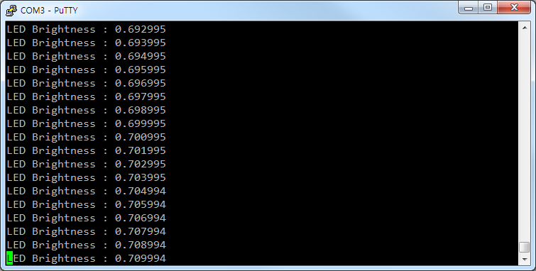
PWM LED Control
root@Hello:~# gcc –lmraa –o led_pwm led_pwm.c
root@Hello:~# ./led_pwm
terminal
source : http://cafe.naver.com/thingdue

Slide 7
GPIO LED Control
GPIO (General Purpose IO)
general purpose IO 인터페이스로, 한 개의 핀으로 입력과 출력 모두를 수행합니다.
mraa_gpio_dir() 함수를 사용하여 입력 또는 출력을 결정
mraa_gpio_init() gpio context초기화
mraa_gpio_write(), mraa_gpio_read() gpio값을 쓰거나 읽기
root@Hello:~# vi led_gpio.c
terminal
source : http://iotdk.intel.com/docs/master/mraa/classmraa_1_1_gpio.html
http://cafe.naver.com/thingdue

Slide 8
GPIO LED Control
#include <stdio.h>
#include <mraa/gpio.h>
int main(){
mraa_gpio_context led;
led = mraa_gpio_init(10);
mraa_gpio_dir(led, MRAA_GPIO_OUT);
while(1){
fprintf(stdout, "LED ON \n");
mraa_gpio_write(led, 1);
sleep(1);
fprintf(stdout, "LED OFF \n");
mraa_gpio_write(led, 0);
sleep(1);
}
mraa_gpio_close(led);
return MRAA_SUCCESS;
}
Example code
source : http://cafe.naver.com/thingdue

Slide 9
Analog I/O – Reading Analog Input
In this section, we learn how to read analog input on Intel Edison.
To read analog input we can use mraa_aio_read()
This function is a part of aio.h file.
- The following is the algorithm to read analog input:
- Initialize aio mraa library by calling mraa_aio_init()
- Set bit value for reading by calling mraa_aio_set_bit()
- Read analog input using mraa_aio_read()
- Call mraa_aio_close() to release aio object usage
AIO : mraa라이브러리를 사용해서 Analog Input/output Interface를 구현
voltage값 Write/Read
AIO Method
- mraa_aio_init ( int pin) : aio context를 초기화 - mraa_aio_read ( mraa_aio_context dev ) : 현재 입력되는 voltage값을 반환 - mraa_aio_close ( mraa_aio_context dev ) : 아날로그 input context를 닫음 ( 다른 context를 위해 메모리를 비움 )
root@Hello:~# vi lightled.c
terminal
source : http://cafe.naver.com/thingdue

Slide 10
Reading Analog Sensor Input -Light
빛에 밝기에 따라 LED 출력
#include <stdio.h>
#include <mraa/aio.h>
#include <mraa/gpio.h>
int main(){
mraa_aio_context LIGHT;
mraa_gpio_context LED;
uint16_t value = 0;
LIGHT = mraa_aio_init(0);
LED = mraa_gpio_init(5);
mraa_gpio_dir(LED, MRAA_GPIO_OUT);
while(1){
value = mraa_aio_read(LIGHT);
fprintf(stdout, "%d\n", value); //output stream
if(value < 50){
mraa_gpio_write(LED,1);
}else{
mraa_gpio_write(LED,0);
}
}
mraa_aio_close(LIGHT);
mraa_gpio_close(LED);
return MRAA_SUCCESS;
}
Example code
source : http://cafe.naver.com/thingdue

Slide 11
Reading Analog Sensor Input -Light
Flame센서 값에 따라 Buzzer 출력
#include <stdio.h>
#include <mraa/aio.h>
#include <mraa/gpio.h>
int main(){
mraa_aio_context FLAME;
mraa_gpio_context BUZZER;
FLAME = mraa_aio_init(1);
BUZZER = mraa_gpio_init(6);
mraa_gpio_dir(BUZZER, MRAA_GPIO_OUT);
while(1){
int value = mraa_aio_read(FLAME);
if(value>100){ //frame value 0~1023
fprintf(stdout, "flame : %d\n", value);
mraa_gpio_write(BUZZER, 1);
}else{
mraa_gpio_write(BUZZER, 0);
}
}
mraa_aio_close(FLAME);
mraa_gpio_close(BUZZER);
return MRAA_SUCCESS;
}
Example code
source : http://cafe.naver.com/thingdue

